Slide 1
Thinking about the way forward …
We’ve learned a lot about the chemistry going on in the atmosphere:
How the Periodic Table is structured in shells (Week 1)
How the atmosphere is structured and what its composition is (Week 2)
How to count (moles) and weigh atoms and molecules (Week 3)
How shells are structured into orbitals (Week 4)
How light interacts with electrons in the atmosphere (Week 6)
How light makes atmospheric molecules vibrate (Week 7)
Valence method and the duet/octet rule (Week 8)
A hack for Lewis structures when these methods don’t work (Week 10, this week)
In the following weeks, we’ll be pivoting to climate change
Modeling the greenhouse effect (Week 11)
Second round of interviews (Week 12)
Combustion analysis and a post-carbon world (Weeks 13)
Global carbon mass balance (Week 14)

Slide 2
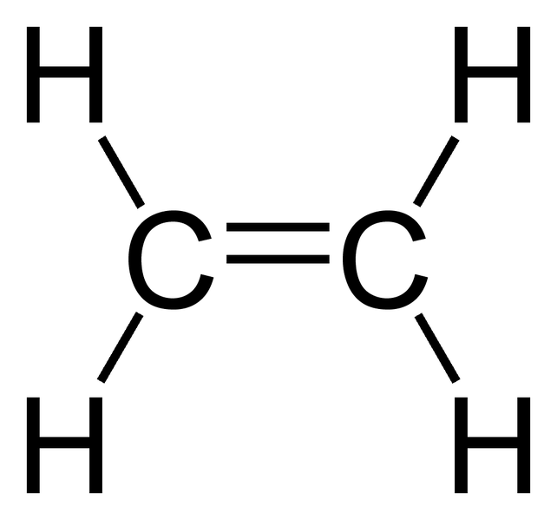
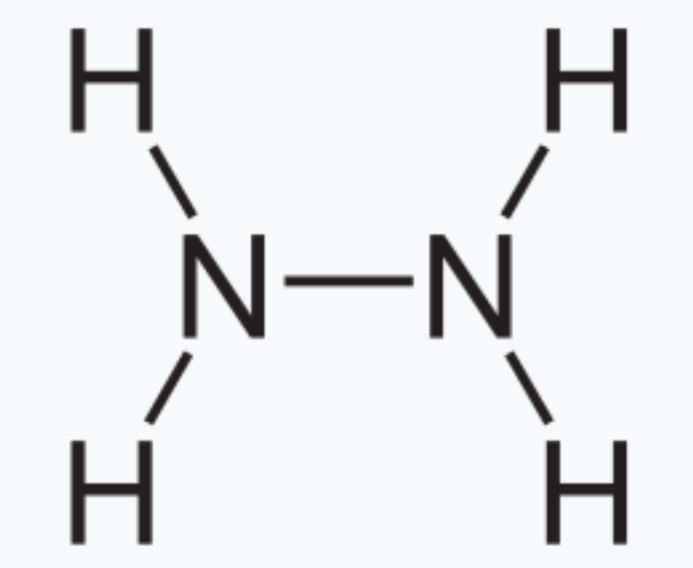
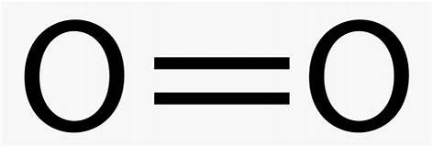
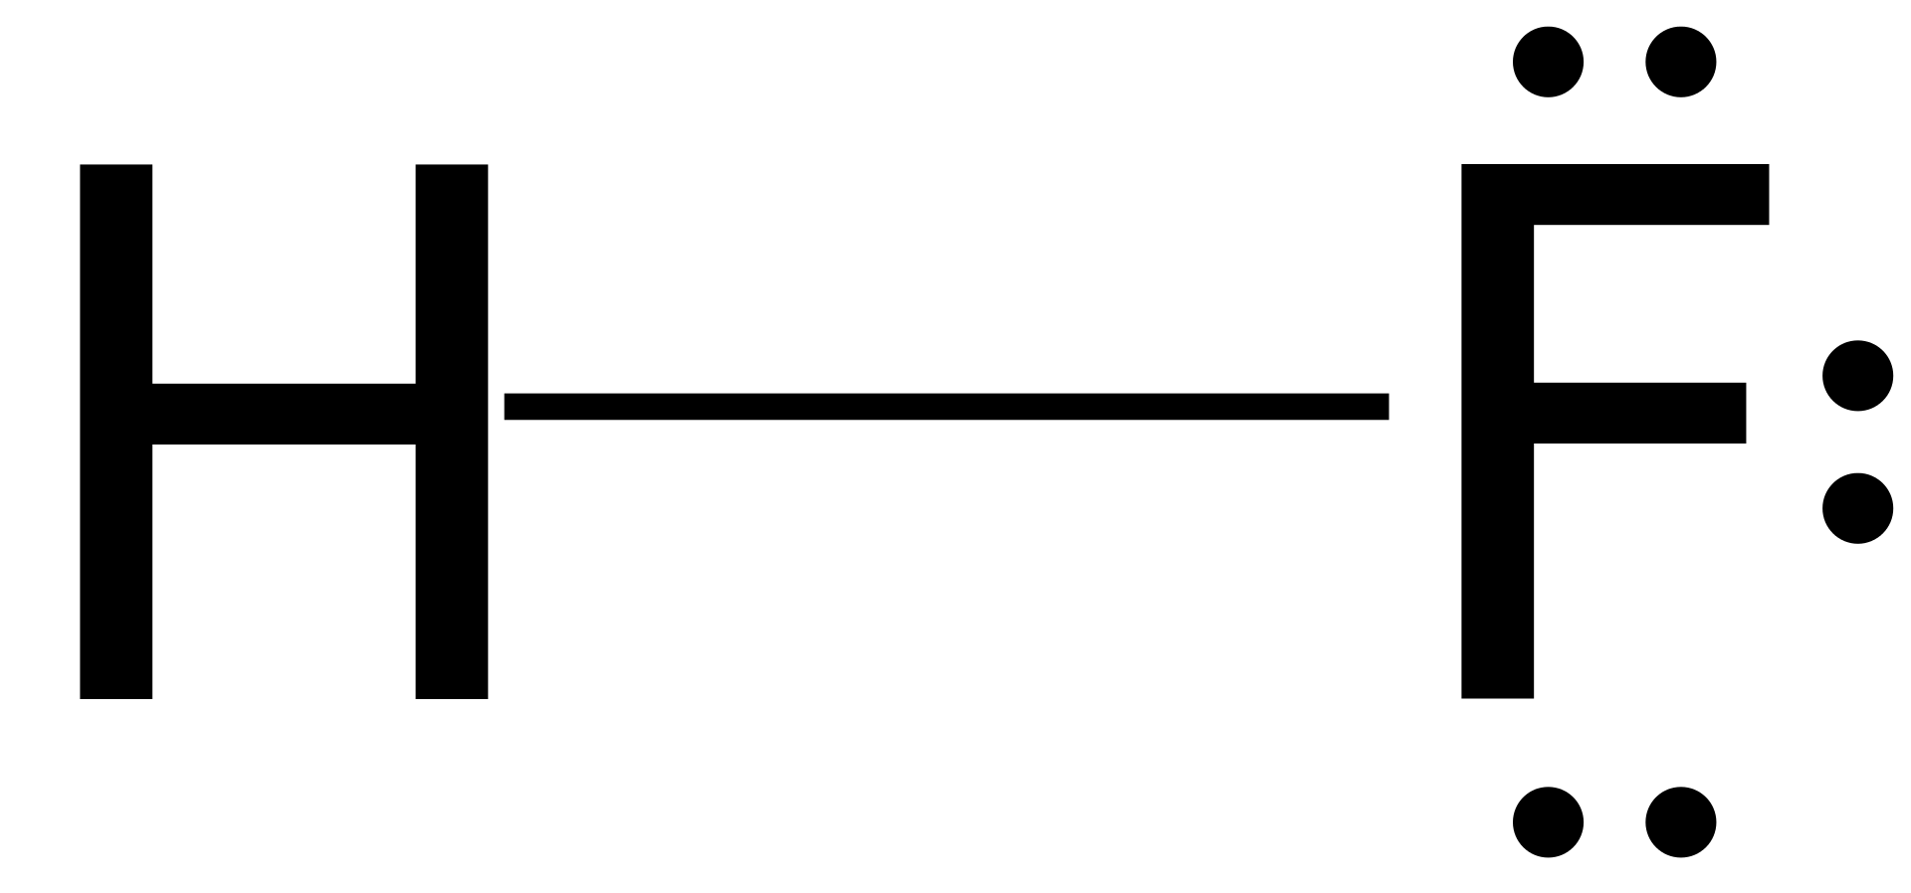
Recap of our method for drawing molecules
The valence method (AKA bond # rule) let us draw molecular structures (lines)
Carbon family makes 4 bonds
Nitrogen family makes 3 bonds
Oxygen family makes 2 bonds
Halogens and Hydrogen make 1 bond
The duet/octet rule let us add in electrons to make Lewis structures (lines+dots):
Two electrons for Hydrogen (paired in a duet)
Eight electrons for C, N, O, and F (four pairs, called an octet)

Slide 3
Exceptions to these rules …
The valence method (AKA bond # rule) let us draw molecular structures (lines)
Carbon family makes 4 bonds
Nitrogen family makes 3 bonds
Oxygen family makes 2 bonds
Halogens and Hydrogen make 1 bond
The duet/octet rule let us add in electrons to make Lewis structures (lines+dots):
Two electrons for Hydrogen (paired in a duet)
Eight electrons for C, N, O, and F (four pairs, called an octet)
Molecules we know exist, but magnetic behavior tells a different story
Molecules we know exist, for which the valence method doesn’t work
Atoms in row 3 of the periodic table or below … we’ll get to this later

Slide 4
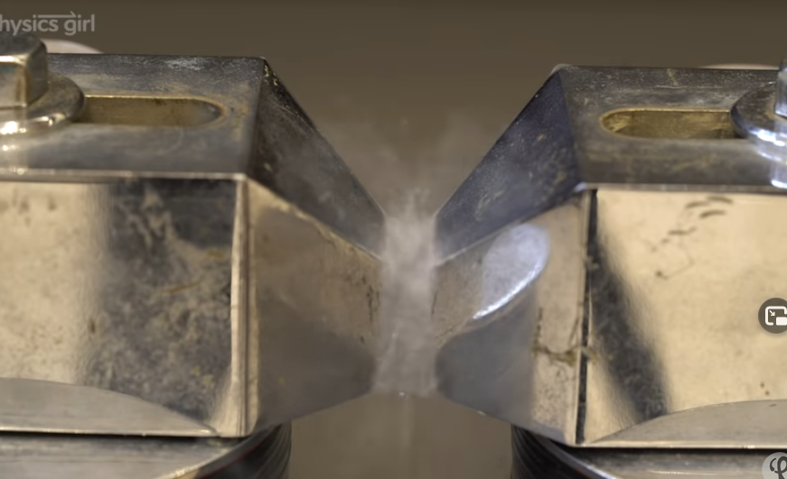
1. Molecules we know exist, but magnetic behavior tells a different story
https://youtu.be/pB-qAwkgfFQ
To be attracted to a magnet, you have to be a magnet. Paired electrons are not magnets, but unpaired electrons are magnets! Molecules are:
Paramagnetic if they have an unpaired electron (attracted to magnets)
Diamagnetic if they don’t have any unpaired electron (not attracted to magnets)

Slide 5
Since O₂ is paramagnetic, this Lewis structure can’t be entirely correct
Is not compatible with

Slide 6
A hack: electron reshuffling + resonance
Electron-reshuffling: exchanging a bond for two electrons (paired or unpaired), or vice versa.
electron-pushing
O O
electron-pushing
O O
electron-pushing
O O

Slide 7
A hack: electron reshuffling + resonance
Electron-reshuffling: exchanging a bond for two electrons (paired or unpaired), or vice versa.
electron-pushing
O O
Not an octet on the right-hand O
electron-pushing
O O
electron-pushing
O O

Slide 8
A hack: electron reshuffling + resonance
Electron-reshuffling: exchanging a bond for two electrons (paired or unpaired), or vice versa.
electron-pushing
O O
Not an octet on the right-hand O
electron-pushing
O O
Not an octet on the left-hand O
electron-pushing
O O

Slide 9
A hack: electron reshuffling + resonance
Electron-reshuffling: exchanging a bond for two electrons (paired or unpaired), or vice versa.
electron-pushing
O O
Not an octet on the right-hand O
electron-pushing
O O
Not an octet on the left-hand O
Almost an octet (7/8) on each oxygen.
electron-pushing
O O

Slide 10
A hack: electron reshuffling + resonance
Electron-reshuffling: exchanging a bond for two electrons (paired or unpaired), or vice versa.
electron-pushing
O O
Not an octet on the right-hand O
electron-pushing
O O
Not an octet on the left-hand O
Almost an octet (7/8) on each oxygen.
Explains why O₂ is paramagnetic (gets stuck in a magnet)!
electron-pushing
O O

Slide 11
A hack: electron reshuffling + resonance
Electron-reshuffling: exchanging a bond for two electrons (paired or unpaired), or vice versa.
electron-pushing
O O
Not an octet on the right-hand O₂
electron-pushing
O O
Not an octet on the left-hand O₂
Almost an octet (7/8) on each oxygen … and explains why O₂ gets stuck in a magnet!
electron-pushing
O O

Slide 12
A hack: electron reshuffling + resonance
Chemists don’t exactly choose between these two forms … Instead, they hedge, and say that the left-hand-side accounts for part of the truth, and the right-hand-side another. This weighted description of reality is called resonance.
resonance
O O
Satisfies octet rule; Maybe weight this 60%
Consistent with magnet experiment;
Maybe weight this 40%

Slide 13
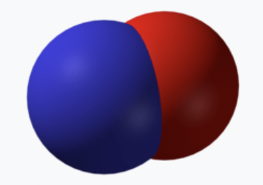
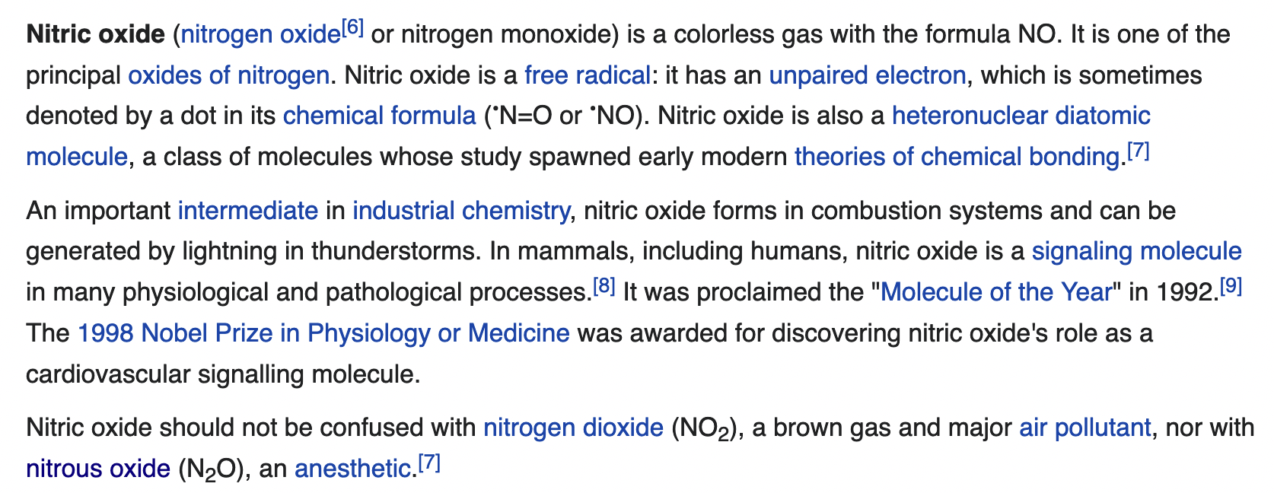
Your turn … NO is paramagnetic. What’s a good Lewis structure for it?

Slide 14
Your turn … NO is paramagnetic. What’s a good Lewis structure for it?
Total of 5+6=11 valence electrons.
N O
Have to have at least these two electrons because there’s a bond … that leaves 9 more electrons … where do they go? (but honor the octet rule for each – not more than 8 electrons around each atom.

Slide 15
Your turn … NO is paramagnetic. What’s a good Lewis structure for it?
Total of 5+6=11 valence electrons.
N O
N O

Slide 16
Your turn … NO is paramagnetic. What’s a good Lewis structure for it?
Total of 5+6=11 valence electrons.
N O
Not OK according to octet rule
N O
OK according to octet rule
Both would be paramagnetic, but we don’t like the 1st because of octet violation. Another way to tell which is better? Compare the observed bond length (1.15 Å) to typical single or double bond lengths for NO

Slide 17
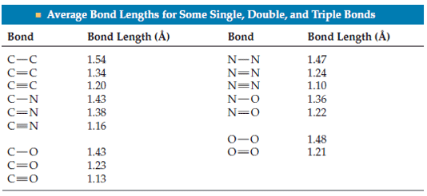
Your turn … NO is paramagnetic. What’s a good Lewis structure for it?
Total of 5+6=11 valence electrons.
N O
OK
Typical bond lengths
N O
OK
Both would be paramagnetic, but we don’t like the 1st because of octet violation. Another way to tell which is better? Compare the observed bond length (1.15 Å) to typical single or double bond lengths for NO

Slide 18
Your turn … NO is paramagnetic. What’s a good Lewis structure for it?
Total of 5+6=11 valence electrons.
N O
OK
Typical bond lengths
N O
OK
Both would be paramagnetic, but we don’t like the 1st because of octet violation. Another way to tell which is better? Compare the observed bond length (1.15 Å) to typical single or double bond lengths for NO

Slide 19
2. Molecules we know exist, for which the valence method doesn’t work
Ozone

Slide 20
2. Molecules we know exist, for which the valence method doesn’t work
Ozone
No

Slide 21
2. Molecules we know exist, for which the valence method doesn’t work
Ozone
No
No

Slide 22
2. Molecules we know exist, for which the valence method doesn’t work
Ozone
No
No
No

Slide 23
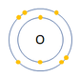
Electron reshuffling + resonance hack to the rescue
Here’s O₂ according to our valence method
Putting six electrons around the oxygen atom because it has six electrons in its outer (valence) shell.

Slide 24
Electron reshuffling + resonance hack to the rescue
Here’s O₂ according to our valence method
There has to be be a bond here, and the electrons can’t come from thin air!
Putting six electrons around the oxygen atom because it has six electrons in its outer (valence) shell.

Slide 25
Electron reshuffling + resonance hack to the rescue

Slide 26
Electron reshuffling + resonance hack to the rescue

Slide 27
Electron reshuffling + resonance hack to the rescue

Slide 28
Electron reshuffling + resonance hack to the rescue
OK

Slide 29
Electron reshuffling + resonance hack to the rescue
OK

Slide 30
Electron reshuffling + resonance hack to the rescue
OK
Also OK

Slide 31
Electron reshuffling + resonance hack to the rescue

Slide 32
Electron reshuffling + resonance hack to the rescue
resonance

Slide 33
Electron reshuffling + resonance hack to the rescue
resonance
Satisfies octet rule
Satisfies octet rule
Both would be diamagnetic (good). Should be equally weighted (50% each). Could compare the observed bond length (1.3 Å) to typical single or double bond lengths for O-O.

Slide 34
Electron reshuffling + resonance hack to the rescue
resonance
Satisfies octet rule
Satisfies octet rule
Both would be diamagnetic (good). Should be equally weighted (50% each). Could compare the observed bond length (1.3 Å) to typical single or double bond lengths for O-O.

Slide 35
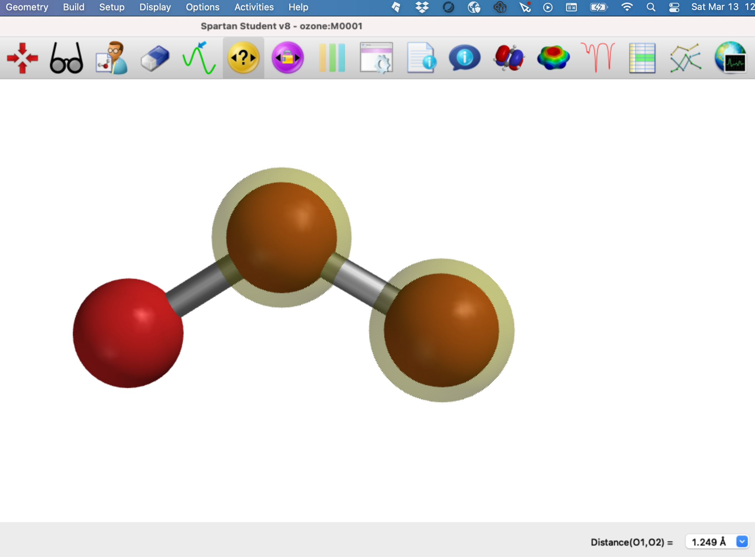
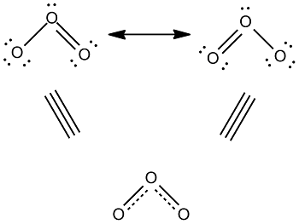
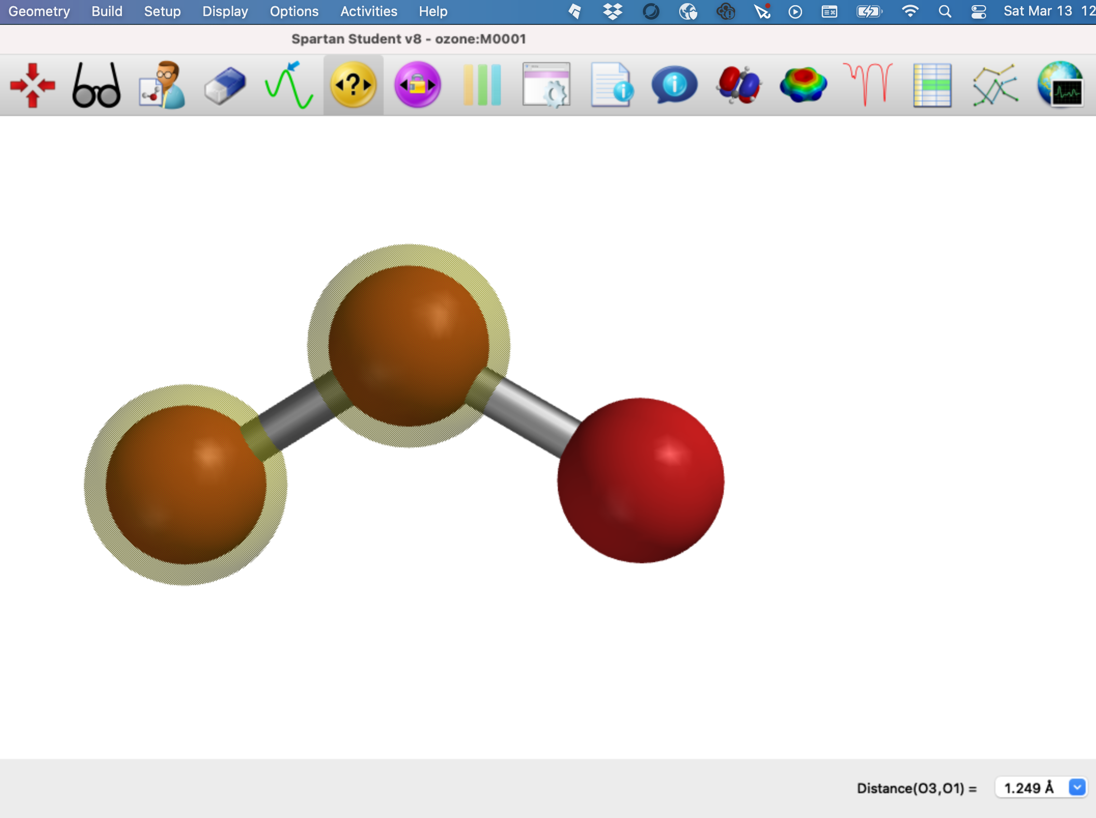
Spartan investigation of bond distances
Check these out in Spartan

Slide 36
Expectations for bond strength
A simplified way of talking about bond strength is to think about how many bonds there are … called the bond order.

Slide 37
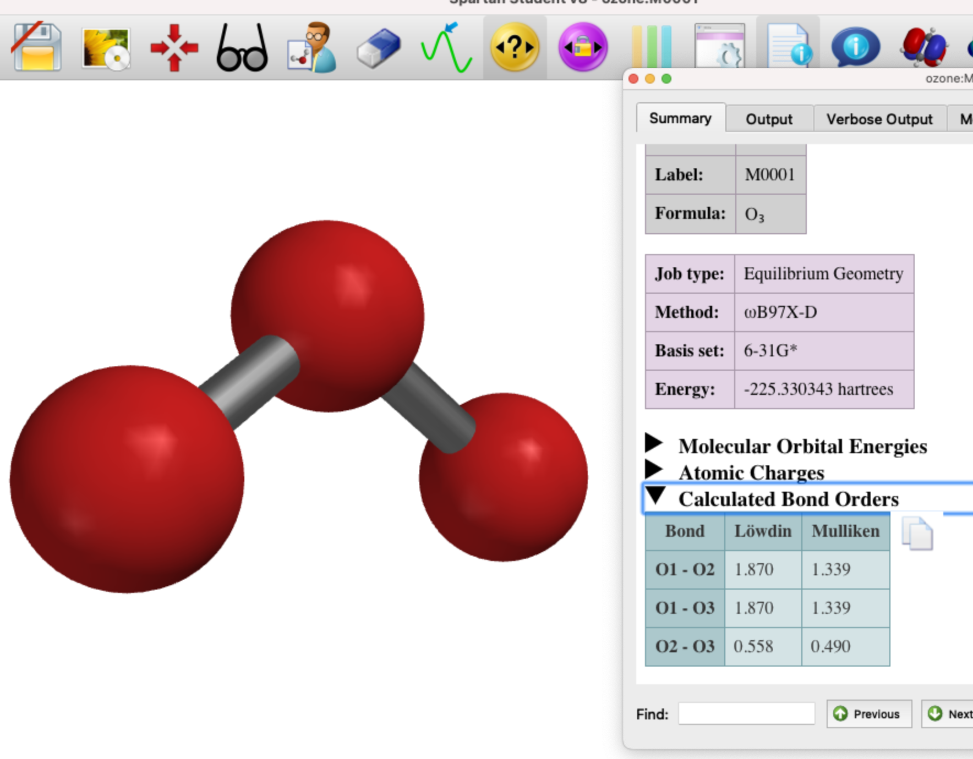
Spartan investigation of bond order
1
2
3
Mulliken bond orders are $\sim 1.4$(and the same for both!)

Slide 38
Summary of our O₃ analysis
What are the expected equivalent alternative resonance forms?
What weights would you assign to each resonance form?
Do any resonance forms lead you to believe O₃ would be attracted to a magnet?
What would you expect the bond length of each O-O bond to be?
What does Spartan say the bond length of each O-O bond is?
What would you expect the bond order of each O-O bond to be?
What does Spartan say the (Mulliken) bond order is?

